Slide 1
THYROID DISEASE DETECTION Detailed Project Report
Team Members
Vishal Rajput
Piyush Chaubey
Divyam Shankhdhar
Suraj Kushwaha
Project Link
Project Video

Slide 2



At least a person out of ten is suffered from thyroid disease in India. The disorder of thyroid disease primarily happens in the women having the age of 17–54. The extreme stage of thyroid results in cardiovascular complications, increase in blood pressure, maximizes the cholesterol level, depression and decreased fertility. The hormones, total serum thyroxin (T4) and total serum triiodothyronine (T3) are the two active thyroid hormones produced by the thyroid gland to control the metabolism of body. For the functioning of each cell and each tissue and organ in a right way, in overall energy yield and regulation and to generate proteins in the ordnance of body temperature, these hormones are necessary .
Hyperthyroidism and Hypothyroidism are the most two common diseases caused by irregular function of thyroid gland. Thyroid disorder can speed up or slow down the metabolism of the body. In the world of rising new technology and innovation, health care industry is advancing with the role of Artificial Intelligence. Machine learning algorithms can help to early detection of the disease and to improve the quality of the life. This study demonstrates the how different classification algorithms can forecasts the presence of the disease. Different classification algorithms such as Logistic regression, Random Forest, Decision Tree, Naïve Bayes, Support Vector Machine, XG Boost, KNN have been tested and compared to predict the better outcome of the model.

Slide 3
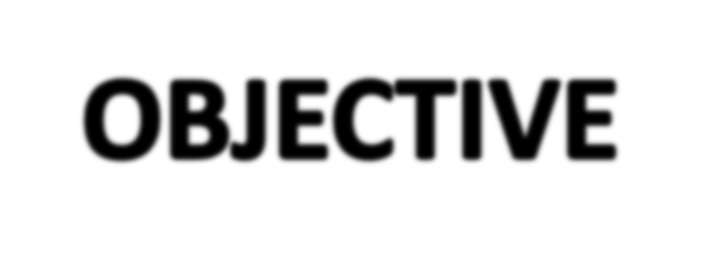

The main goal of this project is to predict the risk of hyperthyroid and hypothyroid based on various factors of individuals. Thyroid disease is a common cause of medical diagnosis and prediction, with an on set that is difficult to fore cast in medical research. It will play a decisive role in order to early detection, accurate identification of the disease and helps the doctors to make proper decisions and better treatment.

Slide 4



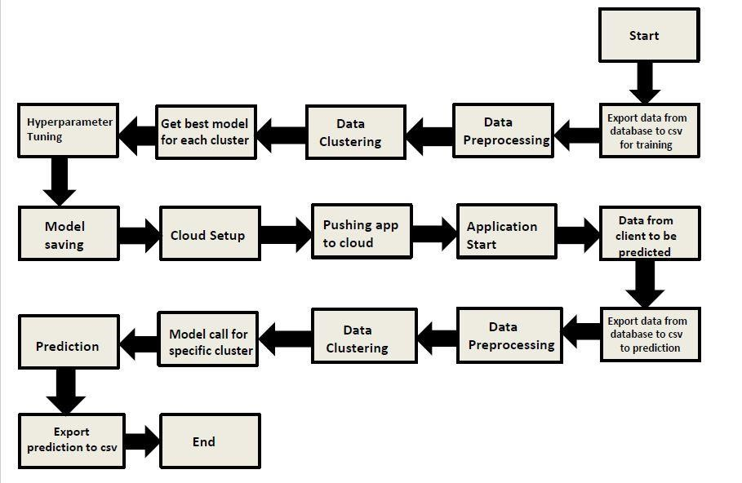

Slide 5

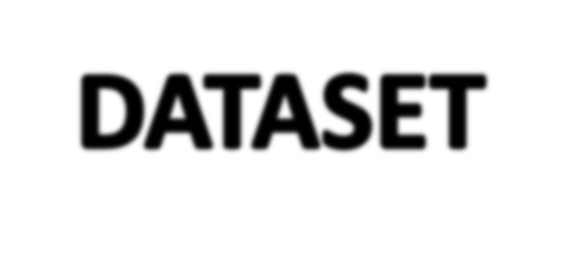

Sex
Age
SSS
TSH Level
Total Thyroxine(TT4)
Free Thyroxine Index
Thyroxine Medication
AntiThyroid Medication
Goitre Test
Thyroid Disease
Hypopituitary
Detection
Iodine Test
T3 Level Measure
Lithium Test
T4 Level Measure
Tumour Test
Psychological Symptoms
TBG Blood Test

Slide 6
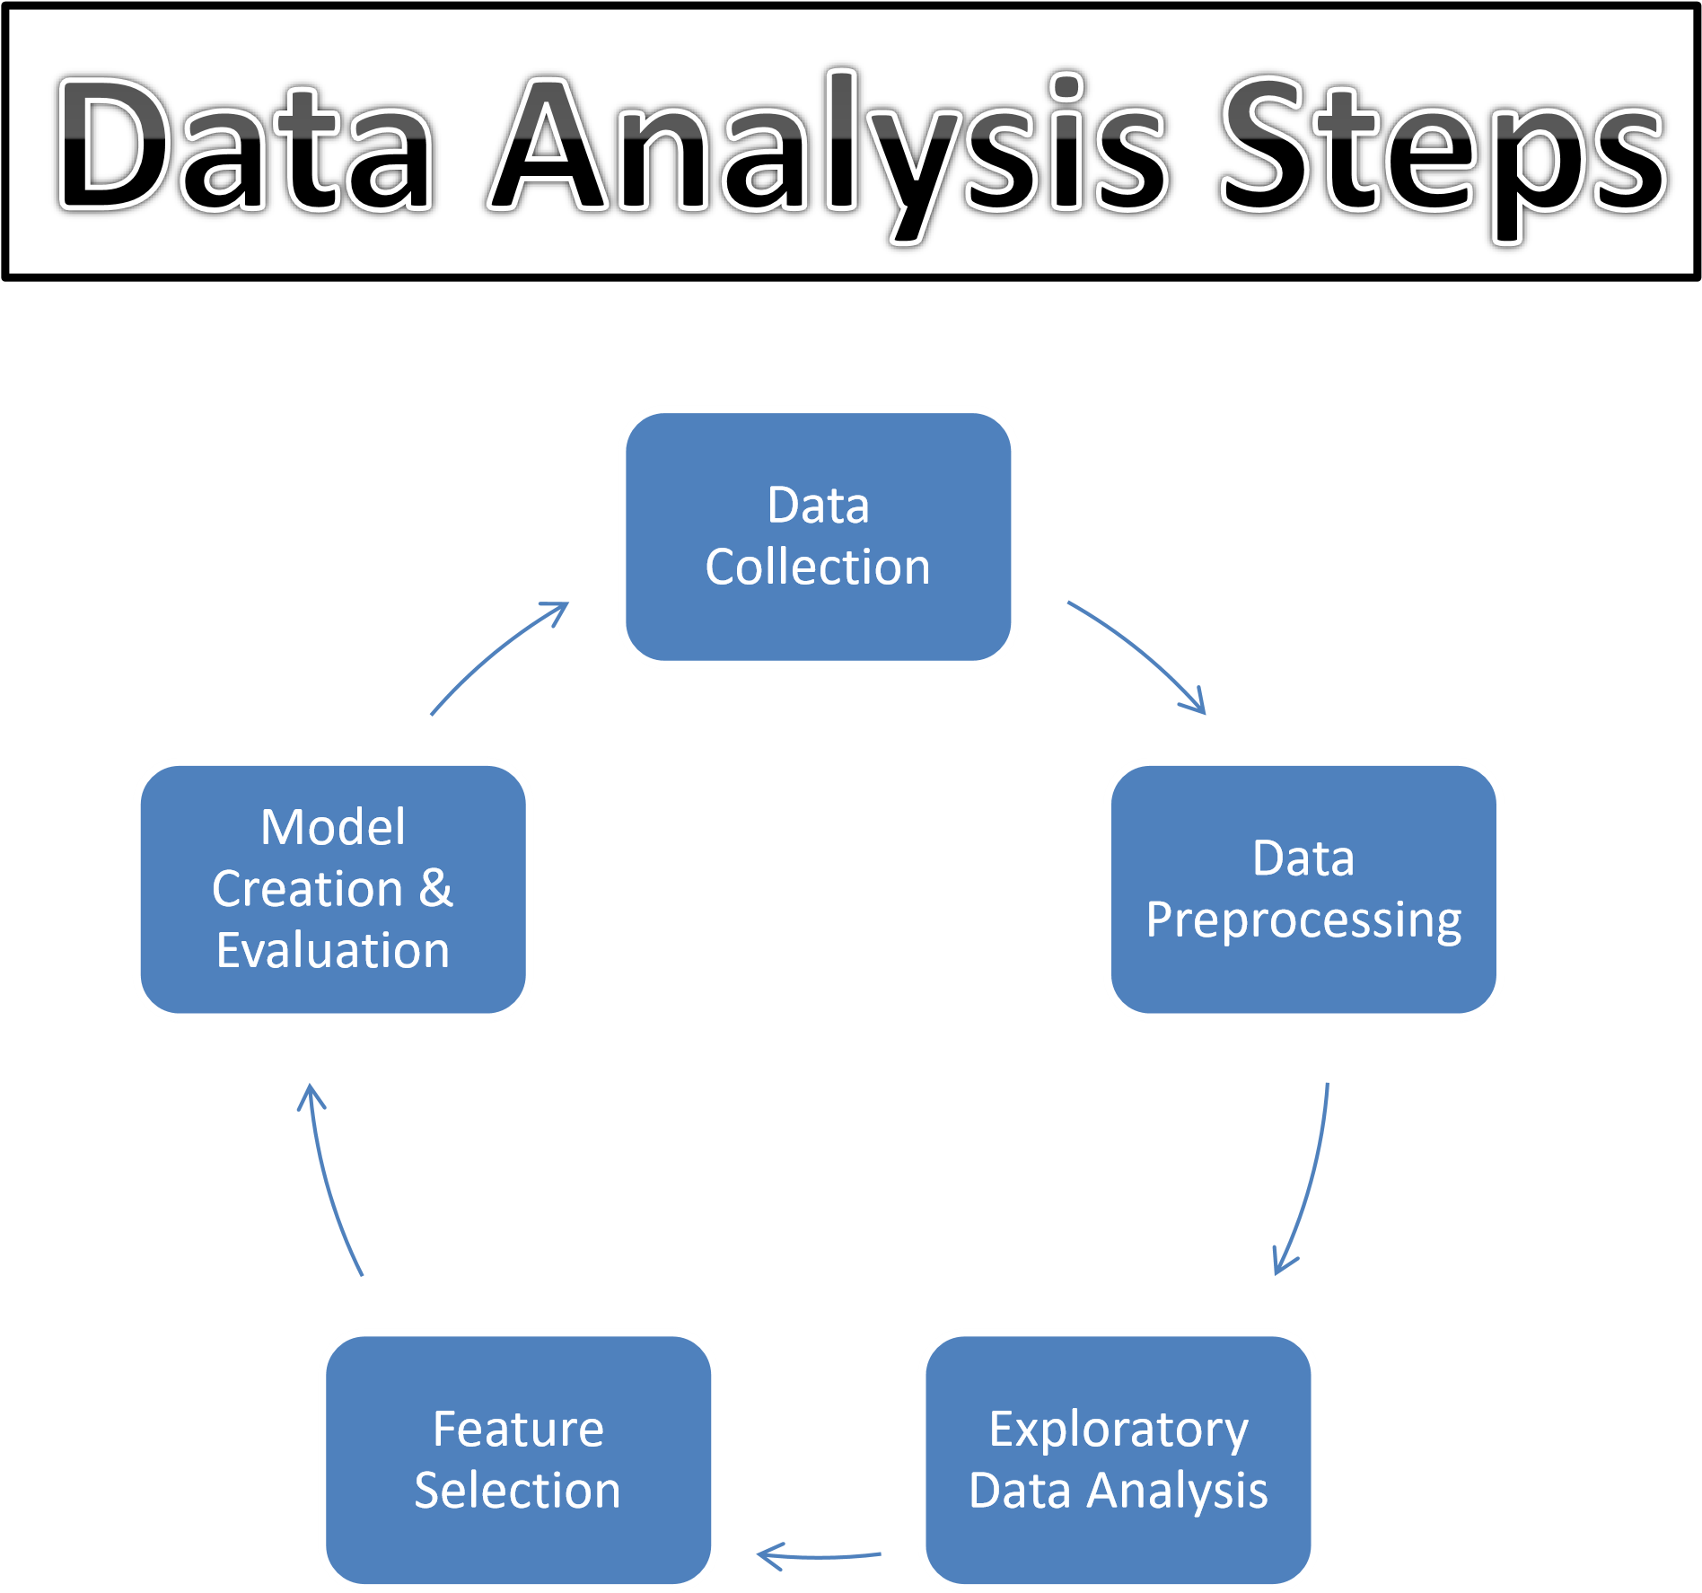

Slide 7
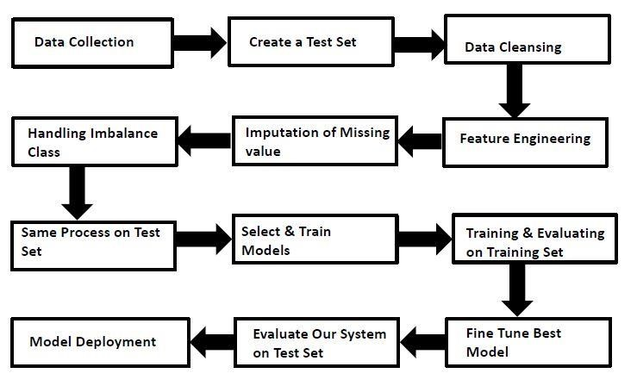
MODEL TRAINING AND VALIDATION WORKFLOW

Slide 8
MODEL TRAINING AND VALIDATION WORKFLOW
Data Collection
Thyroid Disease Data Set from UCI Machine Learning Repository
For Data Set: https://archive.ics.uci.edu/ml/datasets/thyroid+disease
Data Pre-Processing
Missing values handling by Simple imputation (Used KNN Imputer)
Outliers' detection and removal by boxplot and percentile methods
Categorical features handling by ordinal encoding and label encoding
Feature scaling done by Standard Scalar method
Imbalanced dataset handled by SMOTE -Over sampling
Drop unnecessary columns

Slide 9
MODEL TRAINING AND VALIDATION WORKFLOW
Model Creation and Evaluation
Various classification algorithms like Random Forest, XG Boost, KNN etc tested.
Random Forest, XGBoost and KNN all were given better results. XG Boost was chosen for the final model training and testing.
Hyper parameter tuning was performed.
Model performance evaluated based on accuracy, confusion matrix, classification report

Slide 10
XG BOOST CLASSIFIER MODEL
A decision-tree-based ensemble Machine Learning algorithm that uses a gradient boosting framework.
The XGBoost Classifier is a supervised learning algorithm which we can use for regression and classification problems. It is among the most popular machine learning algorithms comes under boosting ensemble technique.
XGBoost Classifier being ensemble algorithm tends to give more accurate result. This is because it works on the principle i.e. number of weak estimators when combined forms strong estimator. Even if one or few decision tree are prone to noise, overall results would tend to be correct.
Reason to use XGBoost Classifier model:
It has high execution speed.
It gives better model performance

Slide 11
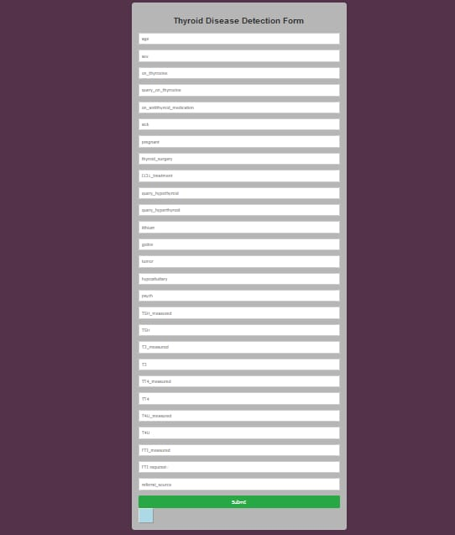
WIREFRAME

Slide 12
FREQUENTLY ASKED QUESTIONS
Q1) What is the source of data?
The data for training is obtained from famous machine learning repository. UCI Machine Learning Repository: https://archive.ics.uci.edu/ml/datasets/thyroid+disease
Q2) What was the type of data?
The data was the combination of numerical and Categorical values.
Q3) What’s the complete flow you followed in this Project?
Refer slide 7th, 8th and 9th for better understanding.this Project?
Q4) After the File validation what you do with incompatible file or files which didn’t pass the validation?
Files like these are moved to the Achieve Folder and a list of these files has been shared with the client and we removed the bad data folder.
Q5) How logs are managed?
We are using different logs as per the steps that we follow in training and prediction like model training log and prediction log etc. And then sub log are inside those folder.
Project?

Slide 13
Q 6) What techniques were you using for data pre-processing?
Removing unwanted attributes
Visualizing relation of independent variables with each other and output variables
Checking and changing Distribution of continuous values
Removing outliers
Cleaning data and imputing if null values are present.
Converting categorical data into numeric values.
Q 7) How training was done or what models were used?
First Data validation done on raw data and then good data insertion happen in DB.
Then Data preprocessing done on final CSV file received from DB.
We did clustering over the data to divide it on desired cluster based on elbow method.
Various model such as Decision Tree, Random Forest and XGBoost models are trained on all clusters and based on performance, for each cluster different model is saved.

Slide 14
Q 8) How Prediction was done?
The testing files are shared by the client .We Perform the same life cycle till the data is clustered .
Then on the basis of cluster number model is loaded and perform prediction. In the end we get the accumulated data of predictions.
Q 9) What are the different stages of deployment?
After model training and finalizing all models. We created required files for deployment.
Finally deployed our model over various cloud platforms such as Heroku and AWS.
Q 10) How is the User Interface present for this project?
For this project I have made two types of UI.
First is for bulk prediction.
Second is for one user input prediction.
Both UI are very user friendly and easy to use

Slide 15
THANK YOU

